Slide 1
1. Corporate Social Responsibility
Topic 3. Corporate Social Responsibility
Chapter 1. Business Basics. Unit 1. The Context of Business.
MXA101 – Introduction To Business
-By ManageX Academy

Slide 2
Corporate Social Responsibility – Introduction
Meaning of Corporate Social Responsibility (CSR)
Why CSR matters in modern business
Shift from profit-only to stakeholder focus
CSR as a strategic necessity

Slide 3
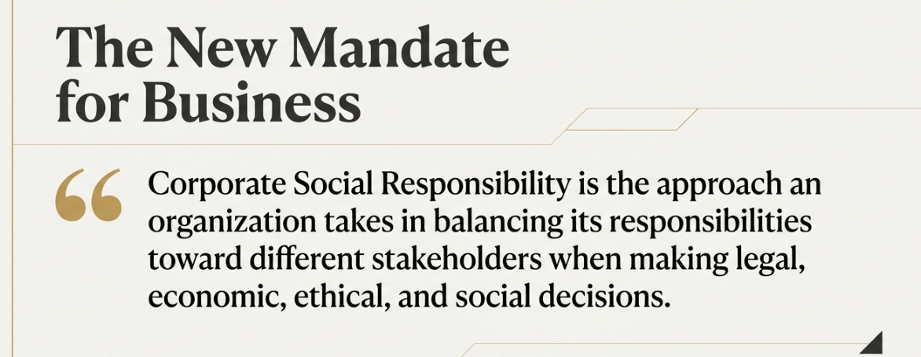
What Is Corporate Social Responsibility?
Balancing economic, legal, ethical, and social duties
Responsibility toward multiple stakeholders
Decision-making beyond profit
Long-term business sustainability

Slide 4
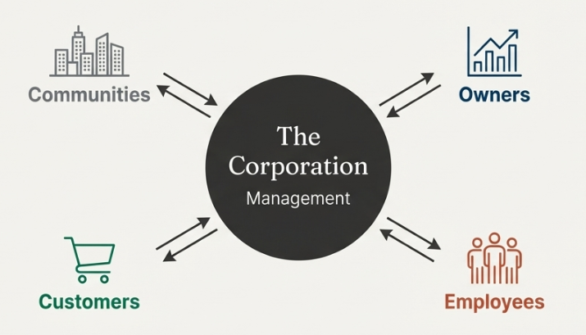
Why Companies Practice CSR
Trust and reputation building
Employee attraction and retention
Investor confidence
Customer loyalty and brand strength

Slide 5
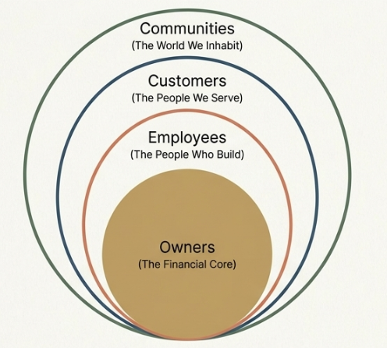
Stakeholder-Centric View of CSR
Owners
Employees
Customers
Communities
Two-way responsibility model

Slide 6
Role of Management in CSR
Managers as decision-makers
Balancing competing stakeholder interests
Ethical leadership
Accountability and transparency

Slide 7
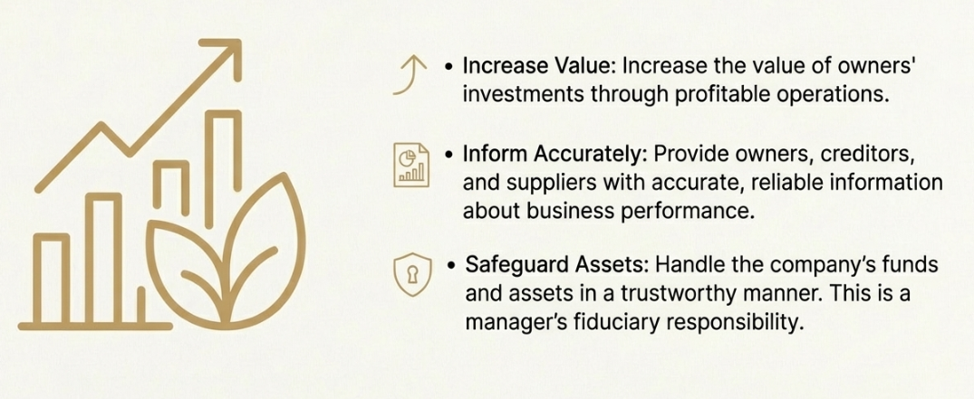
CSR Responsibility Toward Owners
Value creation through profitability
Risk management
Accurate financial reporting
Ethical governance

Slide 8
Fiduciary Responsibility of Managers
Safeguarding company assets
Honest use of funds
Trust-based management
Consequences of ethical failure

Slide 9

CSR Responsibility Toward Employees
Safe and healthy workplace
Fair wages and benefits
Respect and dignity
Equal opportunities

Slide 10

Workplace Safety and Health
Importance of employee well-being
Preventive safety culture
Long-term productivity impact
Moral and operational responsibility

Slide 11
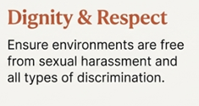
Freedom from Sexual Harassment
Definition of workplace harassment
Zero-tolerance policies
Safe reporting mechanisms
Organizational responsibility

Slide 12
Equal Opportunity and Diversity
Merit-based hiring and promotion
Inclusive workplace culture
Anti-discrimination principles
Business benefits of diversity

Slide 13
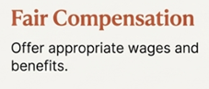
Equal Pay and Wage Fairness
Equal pay for equal work
Gender pay gap challenges
Structural and social causes
Importance of transparent pay systems

Slide 14
Building a Diverse Workforce
Representation of society
Innovation through diversity
Market understanding advantage
Long-term competitiveness

Slide 15
Wages and Employee Benefits
Minimum wage compliance
Fair compensation strategies
Statutory and voluntary benefits
Employee motivation and loyalty

Slide 16
CSR Responsibility Toward Customers
Ethical treatment of customers
Transparency and honesty
Product and service quality
Long-term relationship building

Slide 17
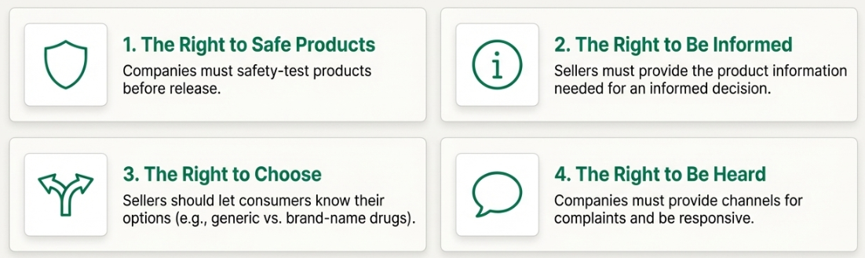
Consumer Rights
Right to safety
Right to information
Right to choice
Right to be heard

Slide 18

CSR Responsibility Toward Communities
Economic impact of businesses
Job creation and tax contribution
Local development support
Social Upliftment

Slide 19
Financial Contributions to Society
Corporate philanthropy
Education, health, and social causes
Structured giving programs
Strategic social investment

Slide 20

Volunteerism and Employee Engagement
Encouraging employee volunteering
Skill-based social contribution
Community connection
Cultural impact within organizations

Slide 21

Supporting Social and Environmental Causes
Health initiatives
Education and sanitation
Environmental sustainability
Global and local impact

Slide 22
CSR as a Strategic Advantage
Brand differentiation
Risk mitigation
Market trust
Long-term profitability

Slide 23
CSR in Indian Business Context
Regulatory expectations
Social responsibility awareness
Stakeholder sensitivity
Corporate reputation in India

Slide 24
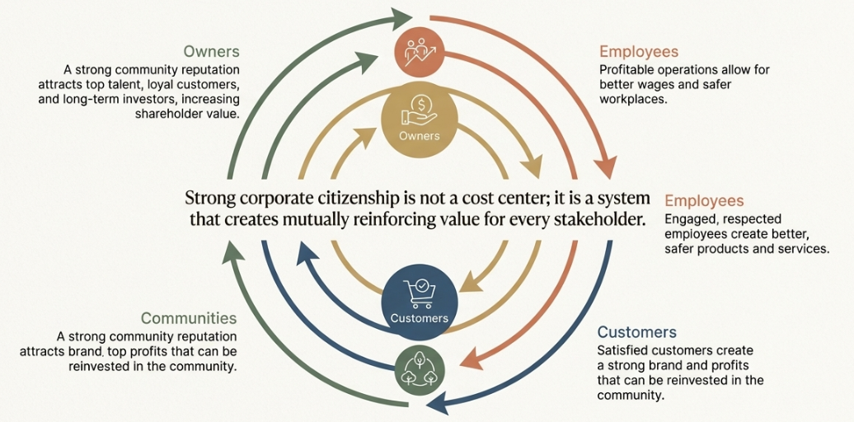
Key Takeaways
CSR is not optional
Stakeholder balance is critical
Ethics and profitability can coexist
Responsible businesses win long-term

Slide 25


